Slide 1
Neuroinflammation & Affective Mood Disorders
Kevin T. Krupp

Slide 2
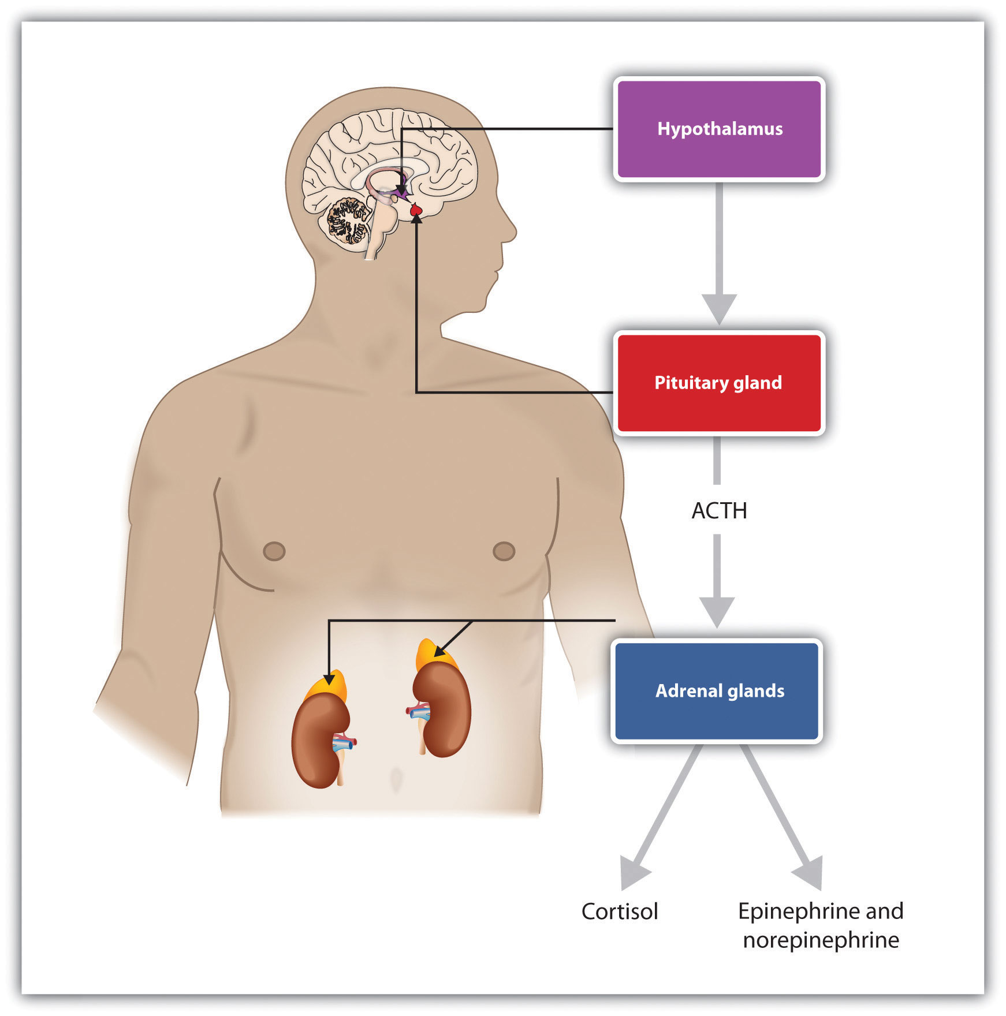
Stress
Overwhelming state & negative emotion
Fight or flight
Adaptative
Notes:
Sympathetic Nervous System activation happen rapidly
Increased attention / arousal
Cort levels increase and peak in blood much later, baseline ~ 2hrs
Try to restore homeostatis
Anti-inflammatory + protective / restorative

Slide 3
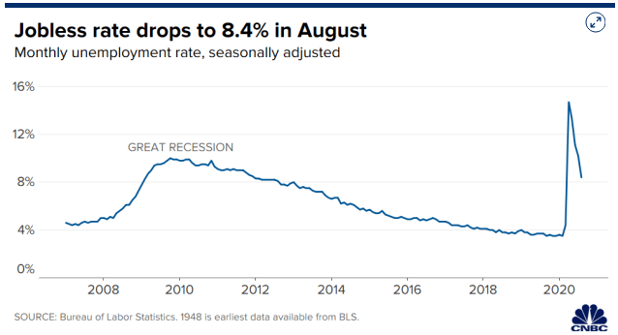
Stress-Related Mood Disorders
Chronic / repeated / uncontrollable stress exposure
(ex. prolonged conflict or low socioeconomic status)
↑ Risk to develop anxious / depressive mood disorder
↑ Symptoms if disorder already present
Susceptible & resilient individuals
Prevalence of depression symptoms ~3 times greater U.S. adults compared to before coronavirus (Ettman et al. 2020)
Notes:
At the end of slide: but how does this work?

Slide 4
Depression
- Firstline Antidepressants (SSRIs, tricyclic antidepressants)
Require weeks for symptom relief
~30% Treatment Resistant (TRD)
- Targeting immune system to
↓ neuroinflammation
May provide better therapy for mood disorders associated with inflammation
like anxiety / depression (Ramming et al. 1997)

Slide 5
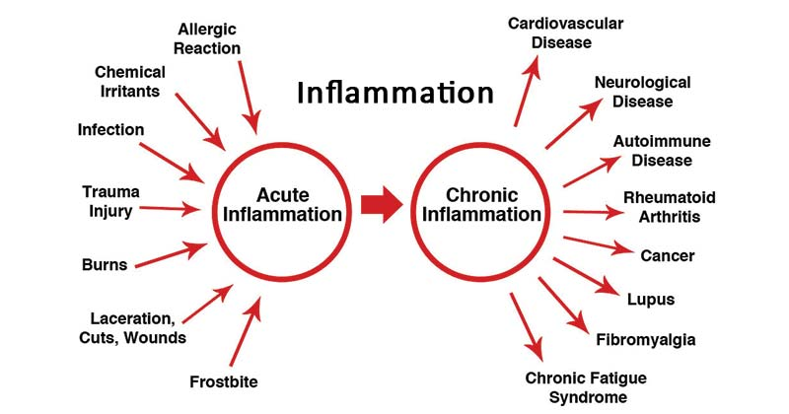
Inflammation
↑ Peripheral pro-inflammatory markers associated with depression (Kohler et al. 2017)
Pro-inflammatory treatment can induce anxious / depressive symptoms
Pro-inflammatory Cytokines
- Signaling molecules that promote inflammation
Process of the body trying to fight against harm & heal itself
Infection, injury, toxins

Slide 6
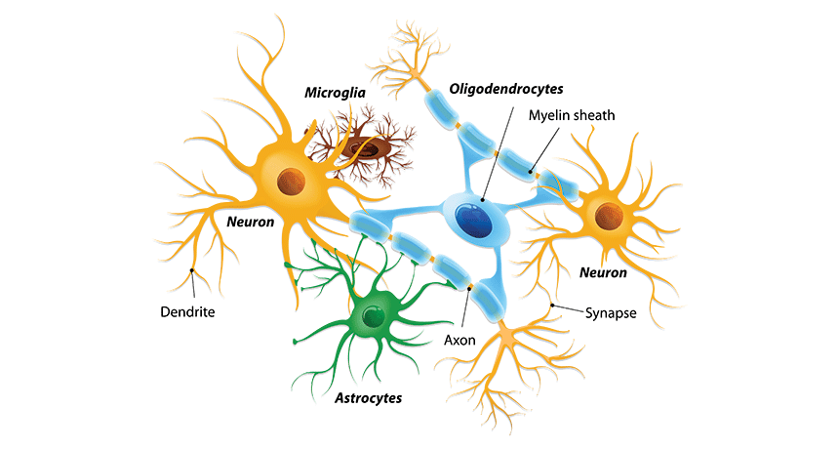
Neuroinflammation
Response of microglia, astrocytes & oligodendrocytes against injuries to CNS
Pathogens
Trauma / chronic Stress
Stroke
Inflammation from periphery

Slide 7
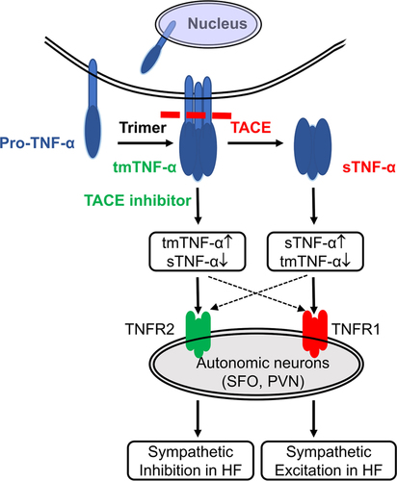
Tumor Necrosis Factor α (TNFα)
-Proinflammatory cytokine
-Regulates physiological processes:
Synaptic plasticity
Learning & memory
Sleep
Food & water intake (Olmos 2014)
- Promotes degradation of prepro-orexin mRNA, orexin protein, & Orexin 2 Receptor protein (Zhan et al. 2011)
Notes:
TNF-α is first synthesized as a transmembrane protein (tmTNF-α). The cleavage of the extracellular domain of tmTNF-α by the matrix metalloprotease TNF-α-converting enzyme (TACE) releases a soluble TNF-α (sTNF-α) homotrimer.

Slide 8
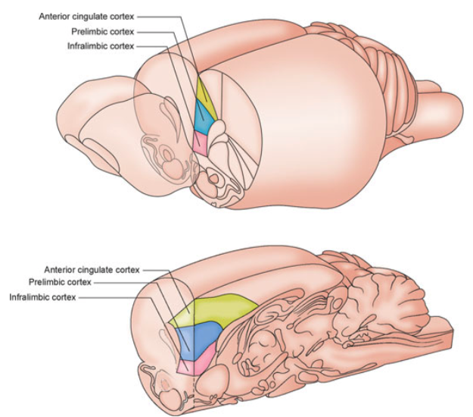
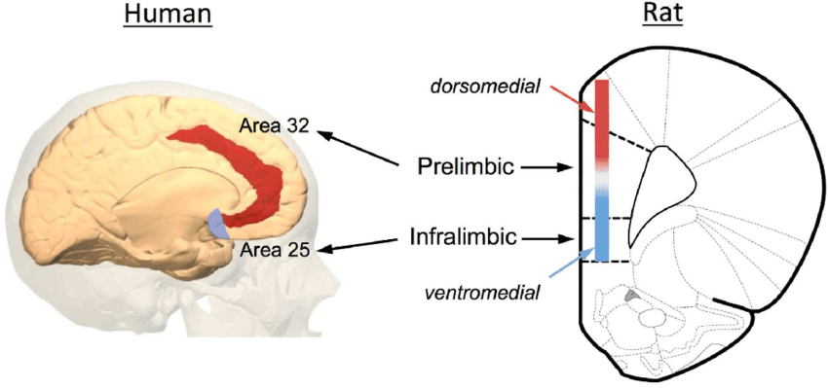
Medial Prefrontal Cortex
Critical role in:
Cognition & learning
Executive control of emotional states
Stress coping strategies
Decision making
Social interaction
PMID: 23512378
Notes:
One player in this story appears to the mPFC

Slide 9
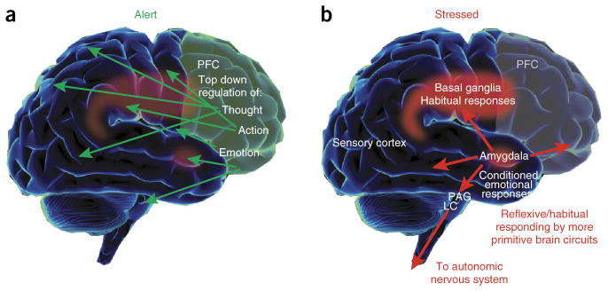
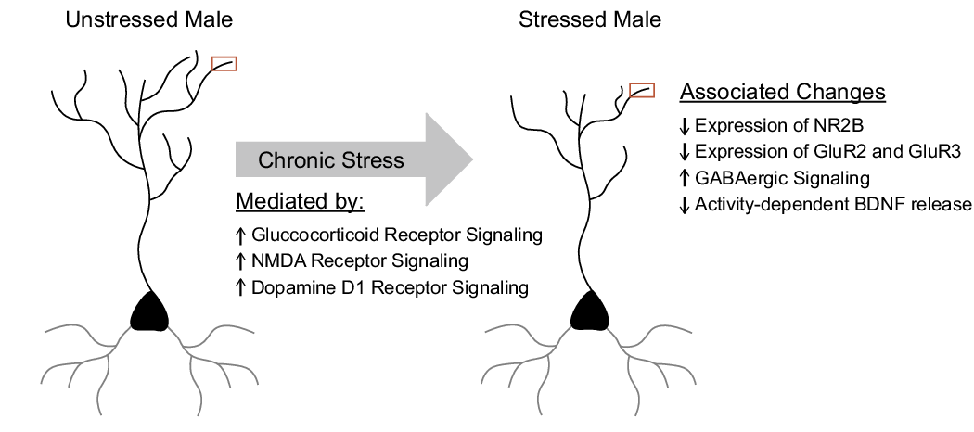
(Wellman & Moench 2018)
Stress can impair function of the PFC
Notes:
- Everyday use usually means a demanding / overwhelming state associated with negative emotions
- For scientists, “fight or flight” is often associated
Adaptive biological mechanisms to help ensure survival
Not “emergency system”, but a process that is ongoing
Might seem unimportant, but this has important implications for understanding stress disorders

Slide 10
How does mPFC relate to stress-resilience and susceptibility ?
→
→
Compared
vulnerable (VUL)
& resilient (RES)
PCR array
mPFC tissue
192 genes
30-minute interaction for 7 days
Notes:
Defeat = submit for 3s
Averages defeat latencies over the 7 days.
Controls placed in a novel empty cage w/ wire mesh for 30 min.

Slide 11
Notes:
Susceptible animals defeated faster than resilient
Expression of S1PR3 mRNA in the mPFC positively correlates with defeat latency (Vul & Res)

Slide 12
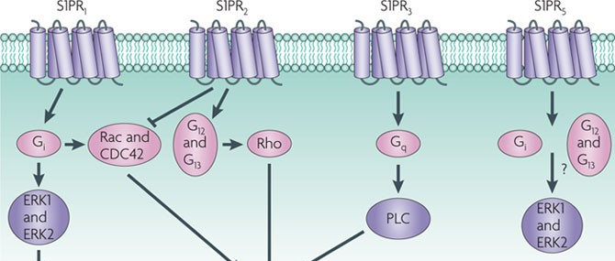
Sphingosine-1-Phosphatase-Receptor 3
Notes:
Just to show there are different type of Receptors and we’re only going to be focusing on one
Not a lot known about what it does in brain, but plays a role in inflammation

Slide 13
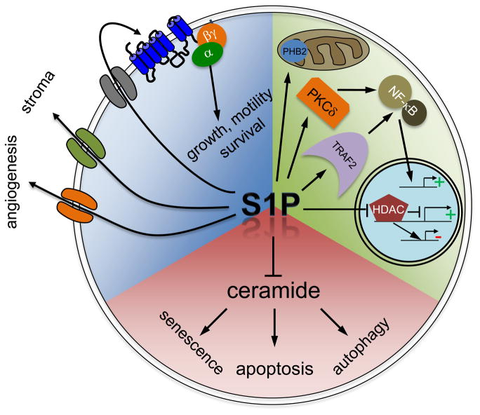
Sphingosine-1-phosphate (S1P)
Signaling sphingolipid
Produced intracellularly
Anti-inflammatory properties
Can act at intracellular targets
Can inhibit functions of its pro-apoptotic precursor ceramide
Can be exported out of cell to act in paracrine or autocrine manner
Notes:
No differences between S1P levels

Slide 14
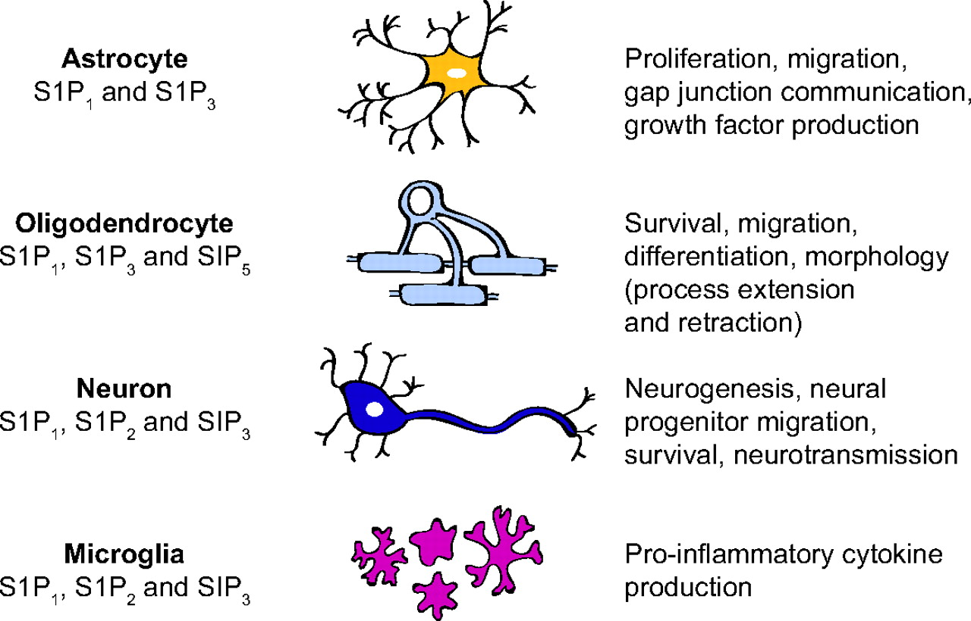
Resilient animals have ↑ in S1PR3 PrL and IL
- Excitatory & inhibitory neurons
Notes:
Focusing on neuronl S1PR3 in neurons in the mPFC, higher expression and differences in excitatory and inhibitory

Slide 15
S1PR3 knockdown in mPFC promotes stress vulnerability
↓ Social Interaction
↑ Immobility
↓ ACTH release

Slide 16
Overexpressing S1PR3 in mPFC promotes stress resilience
↑ Social Interaction
↓ Immobility
↑ ACTH

Slide 17
Knockdown ↓ Lat. to Defeat
Overexpression ↑ Lat. to Defeat
Notes:
Important to note there are no differences in behavior or physiological responses to knockdown or overexpression in NON-STRESSED control animals

Slide 18
Cellular mechanism of S1PR3 in the mPFC?
S1PR3 linked to anti-inflammatory effects in the periphery
↓ immune cell adhesion to endothelial cells
Ionized calcium-binding adapter molecule 1 (IBA1) density
Expressed by microglia and monocytes (mediators of brain inflammation)

Slide 19
SP1R3 KD in mPFC promotes stress vulnerability:
↑ IBA1 in the mPFC
↑ TNF-α in the mPFC
SP1R3 overexpression in mPFC promotes resilience:
↓IBA1 in mPFC
↓ TNF-α in mPFC

Slide 20
Confirmed TNF-α is the proinflammatory marker
Knockdown of S1PR3 & TNF-α together:
- prevents stress vulnerability of
S1PR3 knockdown
Also administered Infliximab (TNF-α inhibitor) into mPFC daily
- also confirmed role of TNF-α

Slide 21
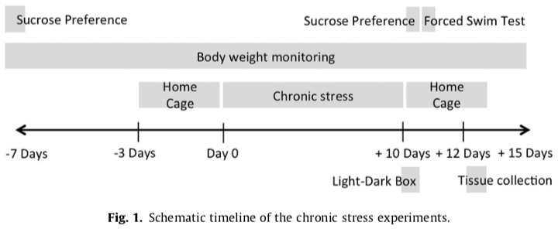
Anhedonia behavioral marker for stress susceptibility or resilience
Sucrose Preference Test
Chronic stress = Restraint stress, Forced Swim Test, or Social Stress
10 days, random sequence each day

Slide 22
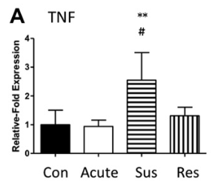
Stress Susceptible Animals
↑ TNFα in PFC
↑ Serotonin Transporter in PFC

Slide 23
Control Animals
Stress-susceptible

Slide 24
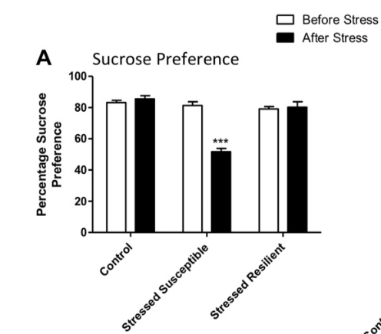
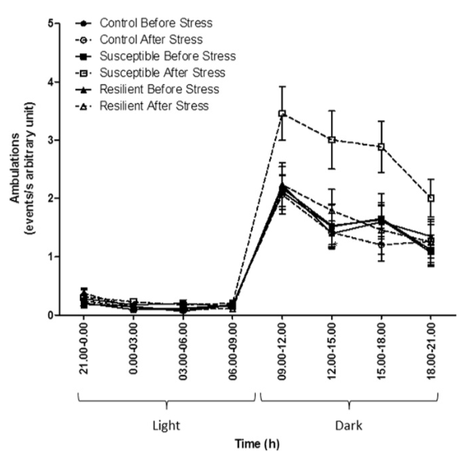
↑ Floating in FST
↓ Latency to float in FST
↑ # of rears in OF
↑ Locomotion in home-cage during dark hours

Slide 25
Summary:
Chronic stress separates animals into stress - susceptible/resilient
Resilient Animals – ↑ expression of S1PR3 in mPFC
Attenuates stress induced behaviors
Attenuates stress induced ↑ in IBA1 & TNF-α in mPFC

Slide 26
Resilient animals show ↑ in S1PR3 in mPFC as a result of stress
- Not pre-existing
(at least in blood)
Suggests transcriptional control of
S1pr3 mRNA in mPFC after stress

Slide 27
Glucocorticoid Receptor (GR)
GRs can act as transcription factors
Evidence of binding sites near S1pr3 gene in rodents
Do GRs regulate expression of S1PR3 in resilient animals in response to stress?

Slide 28
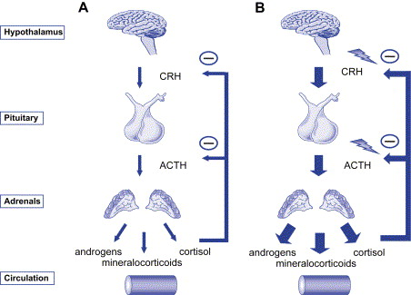
Glucocorticoid Receptor
Limit Stress Response
Restore homeostasis from stress
Potently inhibits inflammatory cytokine production
Suppresses transcription factor NFκB
Notes:
GR thought to be occupied by glucocorticoids during stress or upon awakening (peak of circadian cycle)
Negative Feedback on stress

Slide 29
Glucocorticoid Resistance
Chronic stress exposure
↓GR expression/function
Failure to downregulate pro-inflammatory cytokines like TNF-α, IL-1β, and IL-6

Slide 30
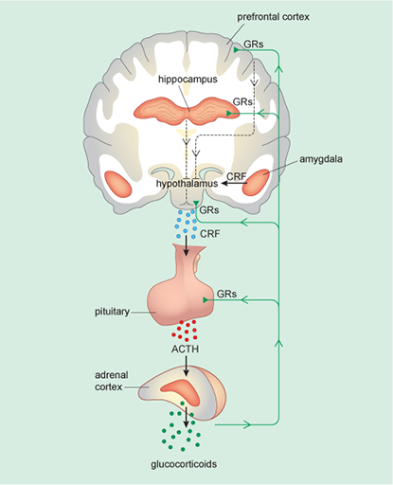
Glucocorticoid Resistance in PFC
Act at GRs in PFC to inhibit HPA axis activity
Prolonged glucocorticoid exposure
GR resistance
HPA axis disinhibition
Notes:
Make note of Hippocampus as well

Slide 31
GR expression in mPFC
Resilient animals
↑ GR in mPFC (IL + PrL)

Slide 32
Knockdown of GR in mPFC
↓ S1PR3 expression in mPFC (IL + PrL)

Slide 33
Knockdown of GR in PrL and IL individually?
shRNA-GR
14 Days
Chronic Variable Stress (CVS)
- 2 repeated, unpredictable, stressors (morning & night)
Warm + cold swims
Cold room exposure
Shaker Stress
Hypoxia
→
→
5-7
days
Notes:
Day 1 and 2 morning stress was FST and OF

Slide 34
Infralimbic Cortex
Prelimbic Cortex
↑ Immobility in FST
↓ Active periods in FST
No change in FST

Slide 35
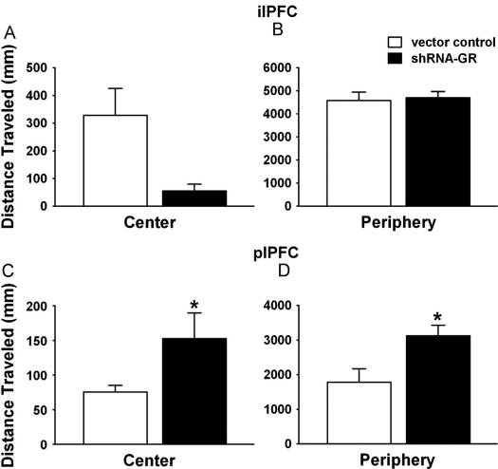
Infralimbic Cortex
Prelimbic Cortex
No change in OF
↑ Locomotion in center & periphery of OF

Slide 36
Infralimbic Cortex
Prelimbic Cortex
IL and PrL GR KD
↑ increase corticosterone release in non-stressed animals
Different responses after CVS
Notes:
Cort response to restraint stress in CVS or no CVS animals

Slide 37
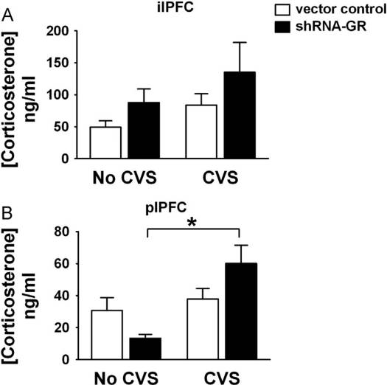
GR KD in the IL
- ↑ immobility in FST
- ↑ Corticosterone release (CVS + no CVS)
GR KD in the PrL
- ↑ Travel in OF
- ↑ Corticosterone (not after CVS)
- ↑ basal morning corticosterone release during chronic stress
Notes:
Baseline measure for CORT

Slide 38
Translation to humans?
Combat exposed war veterans
↓ S1pr3 mRNA in blood of PTSD vets
Inverse correlation between levels of S1pr3 mRNA in blood and:
PTSD symptoms
Depression symptoms

Slide 39
Summary
Expression of GR in mPFC drives transcription of S1PR3 after stress to promote stress resilience after stress
↓ TNF-α
TNF-α increases mPFC in response to stress in stress resilient animals
Multiple types of stress paradigms

Slide 40
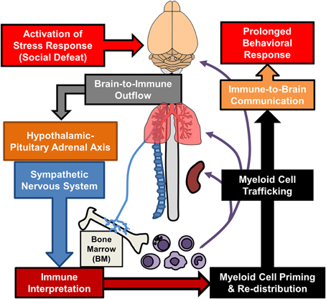
Where social defeat induced TNF-α come from?
Microglia within the mPFC?
Neurons within the mPFC?
Monocytes from periphery?

Slide 41
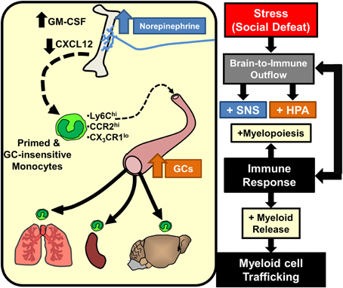

Slide 42
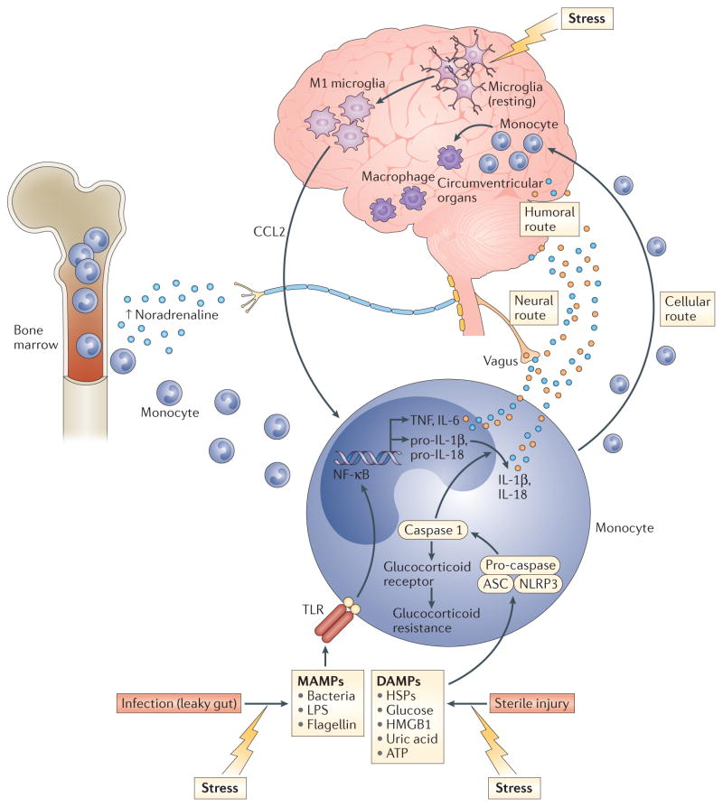

Slide 43
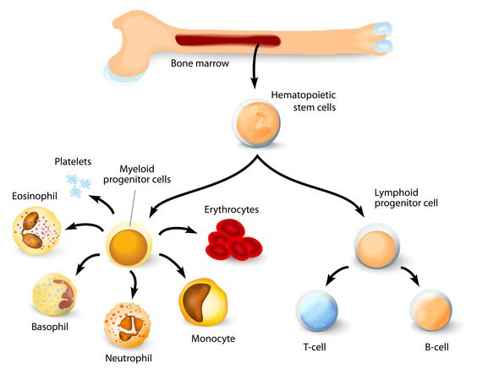

Slide 44
Chronic Stress ↑ 5-HT_{2A} in PFC of Susceptible and Resilient Animals
Notes:
Note – this wasn’t the mPFC

Slide 45
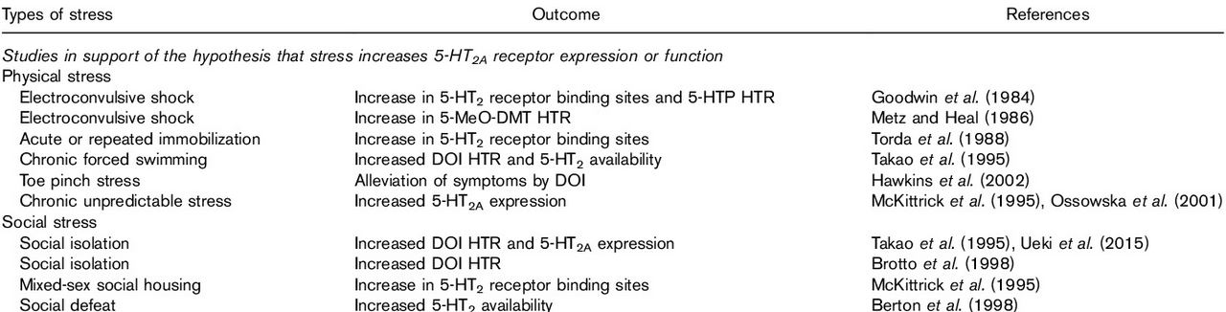
Many stressors shown to ↑ 5-HT_{2A} levels / function
(Murnane 2019)
↑ 5-HT_{2A} expression in PFC of teenage suicide victims (Pandey et al. 2002)
↓ 5-HT_{2A} contribute to therapeutic effects of Mirtazapine and Mianserin
(Davis and Wilde, 1996; Golden et al., 1998).
Notes:
Only part of table shown, some papers show opposite results – but probably due to timing of experiments

Slide 46
Prelimbic Cortex
↑ fear learning
↓ social interaction
Infralimbic Cortex
↑ Fear extinction learning
↑ Social interaction

Slide 47
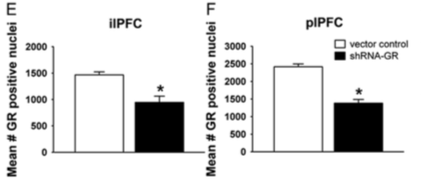
(Price et al. 2019)
Lower GR levels in IL (~1/2)
compared to PrL
(non-stressed rats)
Lower 5-HT_{2A} levels in IL (~1/2)
(non-stressed rats)

Slide 48
- Whole brain downregulation of GR in rat brain (Islam et al. 2004)
↑ 5-HT_{2A} receptor mRNA expression (13%) and binding (21%) in frontal cortex.
- Evidence GRs suppress 5-HT_{2A} transcription (Falkenberg et al. 2011)

Slide 49
5-HT_{2A} also has roles in:
-Glutamate release
-BDNF interactions
-Endocannabinoid secretion
-Modulation of Mitochondria

